Slide 1
Report Mumbai Analysis

Slide 2

Index
Introduction
Data
Methodology
Result
Discussion
Conclusion

Slide 3
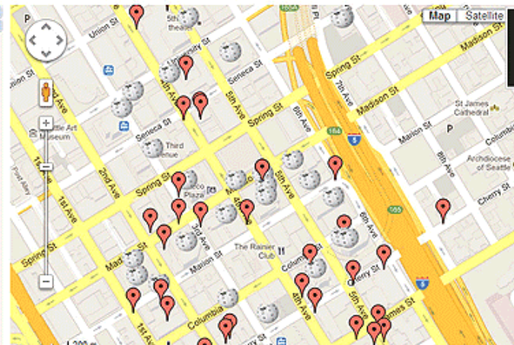
Introduction
Analyze places using foursquare api

Slide 4

Data
The data has been collected and stored in a dataframe using places api

Slide 5
Methodology
The python commands and api together help us to find and sort places in a particular
area on the basis of their ratings and representing it using matplotlib functions in the form of different
graphs and visualization.

Slide 6

Result
we are able to find the top rated places in an area

Slide 7
Discussion
We see that not only eating points,but also places are also rated according to their
importance in that area. For example, a petrol pump would be very high rated in an area with no other
petrol pumps around.

Slide 8
Conclusion
Using python libraries and google api,we can analyze an area to get the best places
available by seeing the user ratings.

Slide 9

Capstone Project

